Slide 1


GradeUp
Interactive Learning and Teaching Platform
Shokry Arraf, Amran Zoabi
Dr. Natali Levi

Slide 2



Introduction
Traditional Classroom education, often faces significant challenges in maintaining student engagement and catering to diverse learning styles.
1

Slide 3



Traditional Classroom Challenges
Emergency Situations
One of the biggest challenges that face the educational system are emergency situations such as conflicts, pandemics, or natural disasters.
2

Slide 4
Traditional Classroom Challenges
One-size-fits-all
In the contemporary educational landscape, the one-size-fits-all approach is increasingly seen as inadequate.
Challenges:
Maintaining student engagement
Catering to diverse learning styles
3

Slide 5
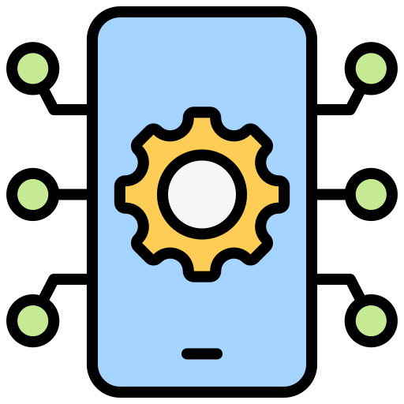
Traditional Classroom Challenges
Delivery and Progress Tracking
Teachers are often overwhelmed by the dual task of delivering educational content and tracking student progress in real-time.
4

Slide 6

Related Work
Negatives:
No communication between student and teacher
No motivational elements to keep students engaged
5

Slide 7
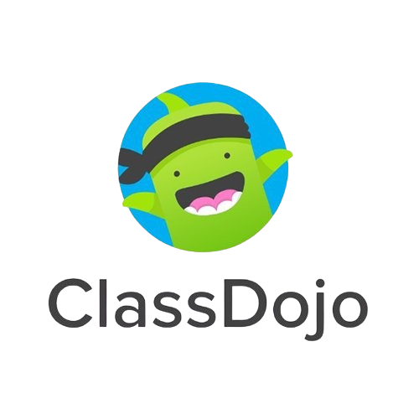
Related Work
Negatives:
No personalized learning
Lacks accessibility
6

Slide 8

Related Work
Negatives:
No personalized learning
No motivational elements to keep students engaged
7

Slide 9
Solution
GradeUp – an Interactive Learning and Teaching Platform
This project aims to develop a robust software application that leverages cloud technology, gamification, and real-time analytics to transform traditional educational methods into a more dynamic and responsive system.
8

Slide 10
Solution
GradeUp – an Interactive Learning and Teaching Platform
Interactive Learning Modules
Real-Time progress tracking
Continuous assessment
9

Slide 11



Solution
GradeUp – an Interactive Learning and Teaching Platform
Furthermore, GradeUp will incorporate gamified elements, such as:
Badges
Rewards
Achievements
These features will make learning enjoyable, help sustain student interest and motivation.
10

Slide 12

Solution
GradeUp – an Interactive Learning and Teaching Platform
For educators, GradeUp will provide a suite of powerful tools to create, customize, and manage lesson plans, making it easier to implement targeted and effective teaching strategies.
11

Slide 13

Solution
GradeUp – an Interactive Learning and Teaching Platform
In addition to its educational features, GradeUp is equipped with emergency alerts and safety protocols to ensure continuous learning during disruptions.
12

Slide 14

Algorithms
Personalized Learning Paths
Each student will get a personalized learning path depending on:
Learning Rate
Skill Level
The subjects and tasks will have elements that set their pace and difficulty to help integrate them with the students’ attributes.
13

Slide 15
Algorithms
Other Algorithms
Real-Time Feedback Mechanisms
Engagement Metrics: The algorithm continuously monitors how students interact with various elements of the platform.
Reward Systems: The platform leverages reinforcement learning to optimize the distribution of rewards.
14

Slide 16
Models
Student Performance Model
Predictive Analytics: This model uses historical data on student performance to predict future outcomes.
Progress Tracking: This component continuously monitors and records student progress across different subjects and tasks.
Adaptive Difficulty Model
Adaptive Difficulty: The model dynamically adjusts the difficulty level of educational content based on real-time assessments of a student's capabilities.
15

Slide 17



Architecture
UI Layer
UI Layer
State Holders
Domain Layer
Data Layer
16

Slide 18
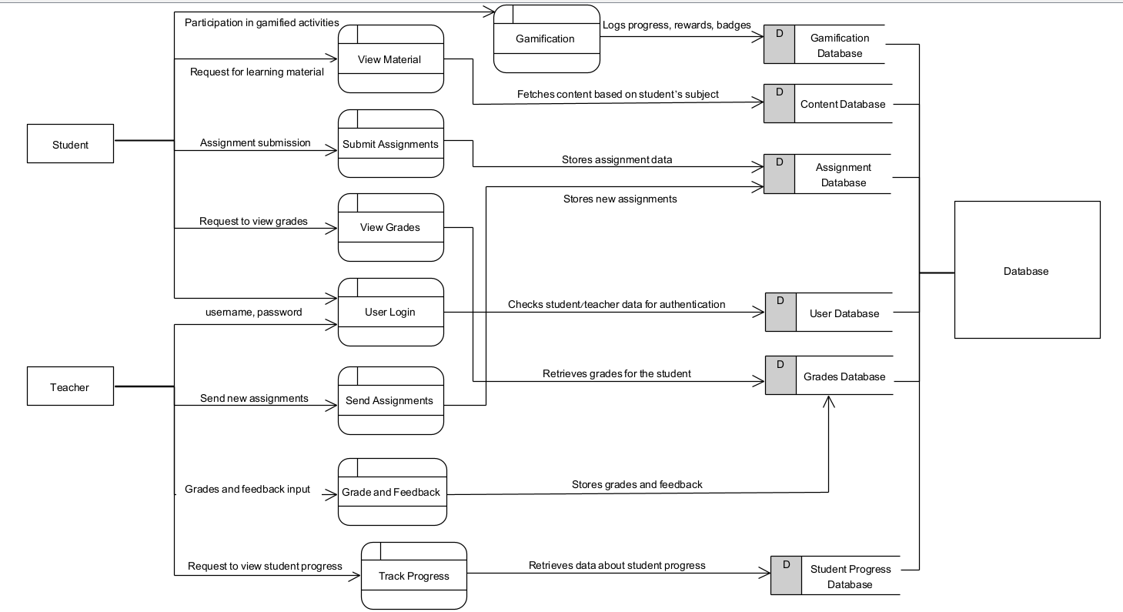

DataFlow
17

Slide 19
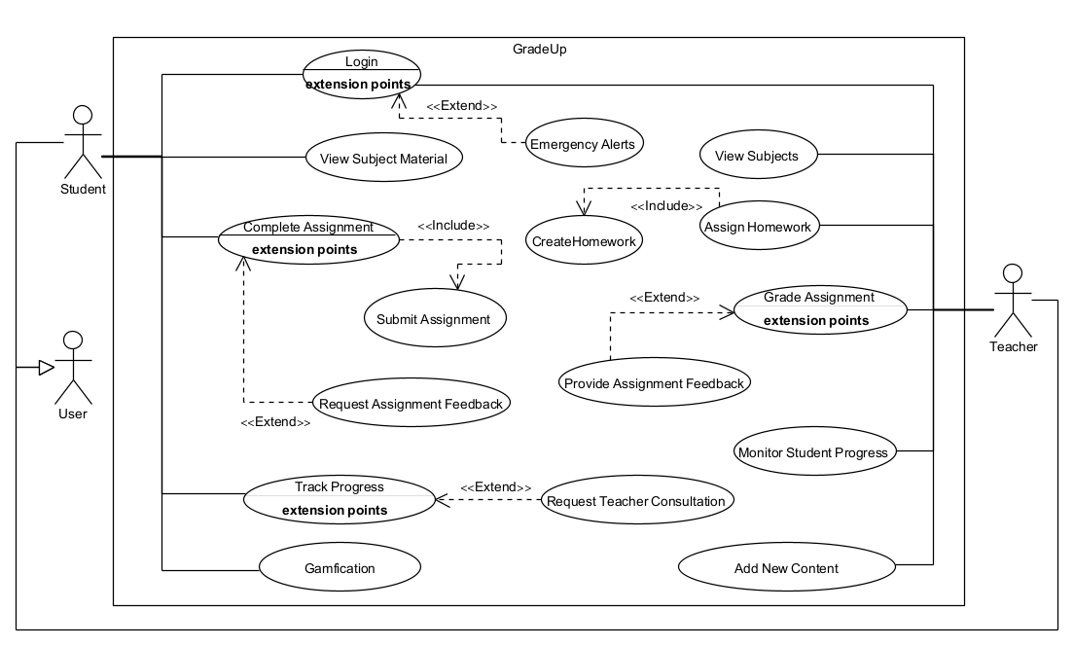
Use-Case
18

Slide 20
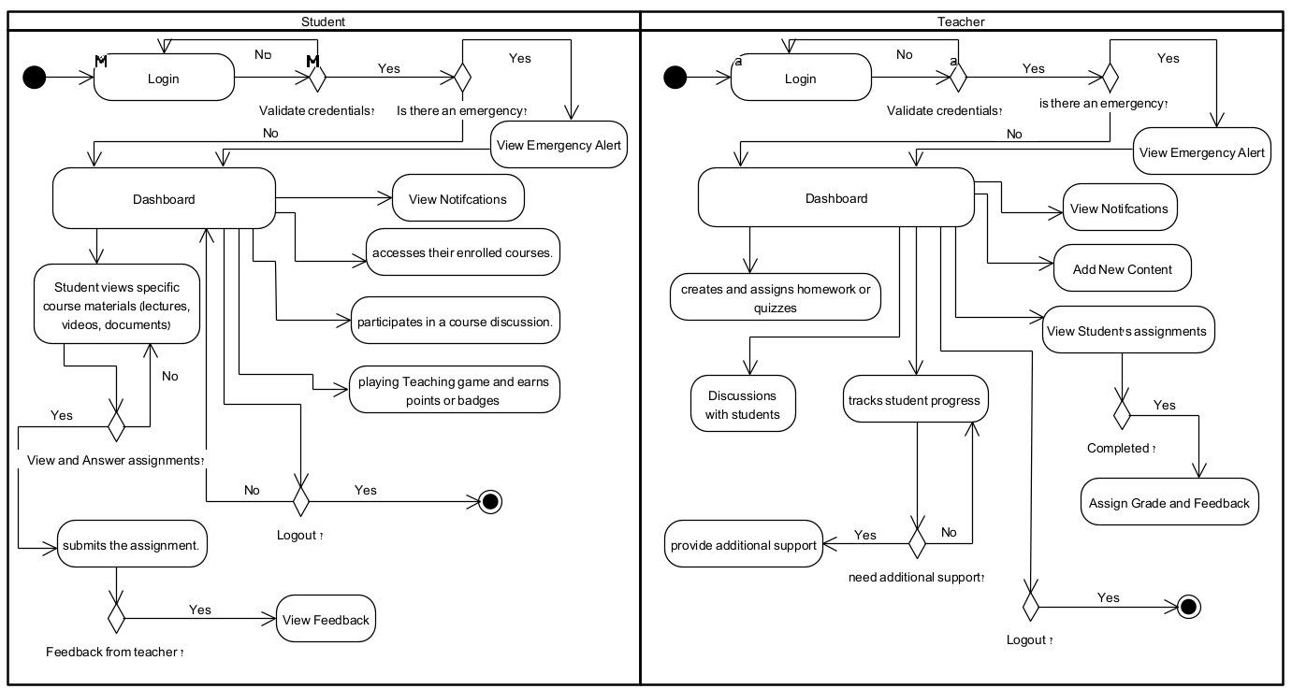
Activity
19

Slide 21
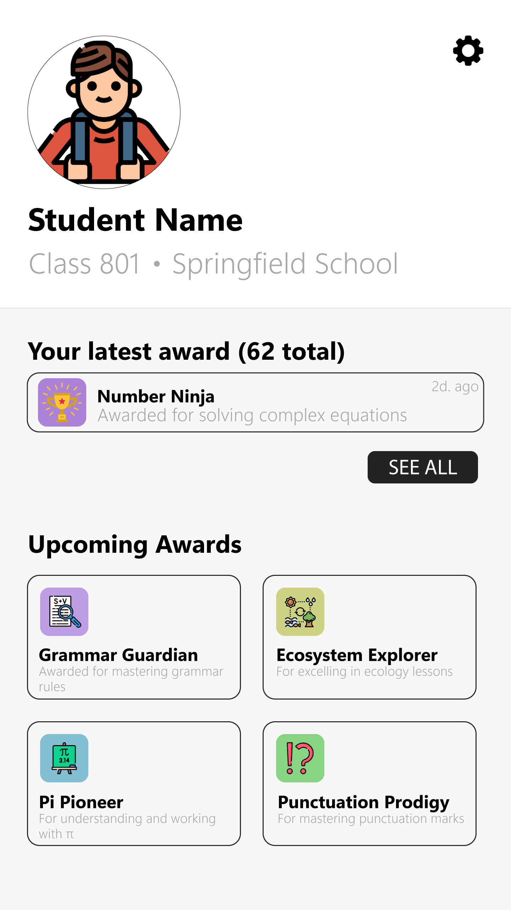
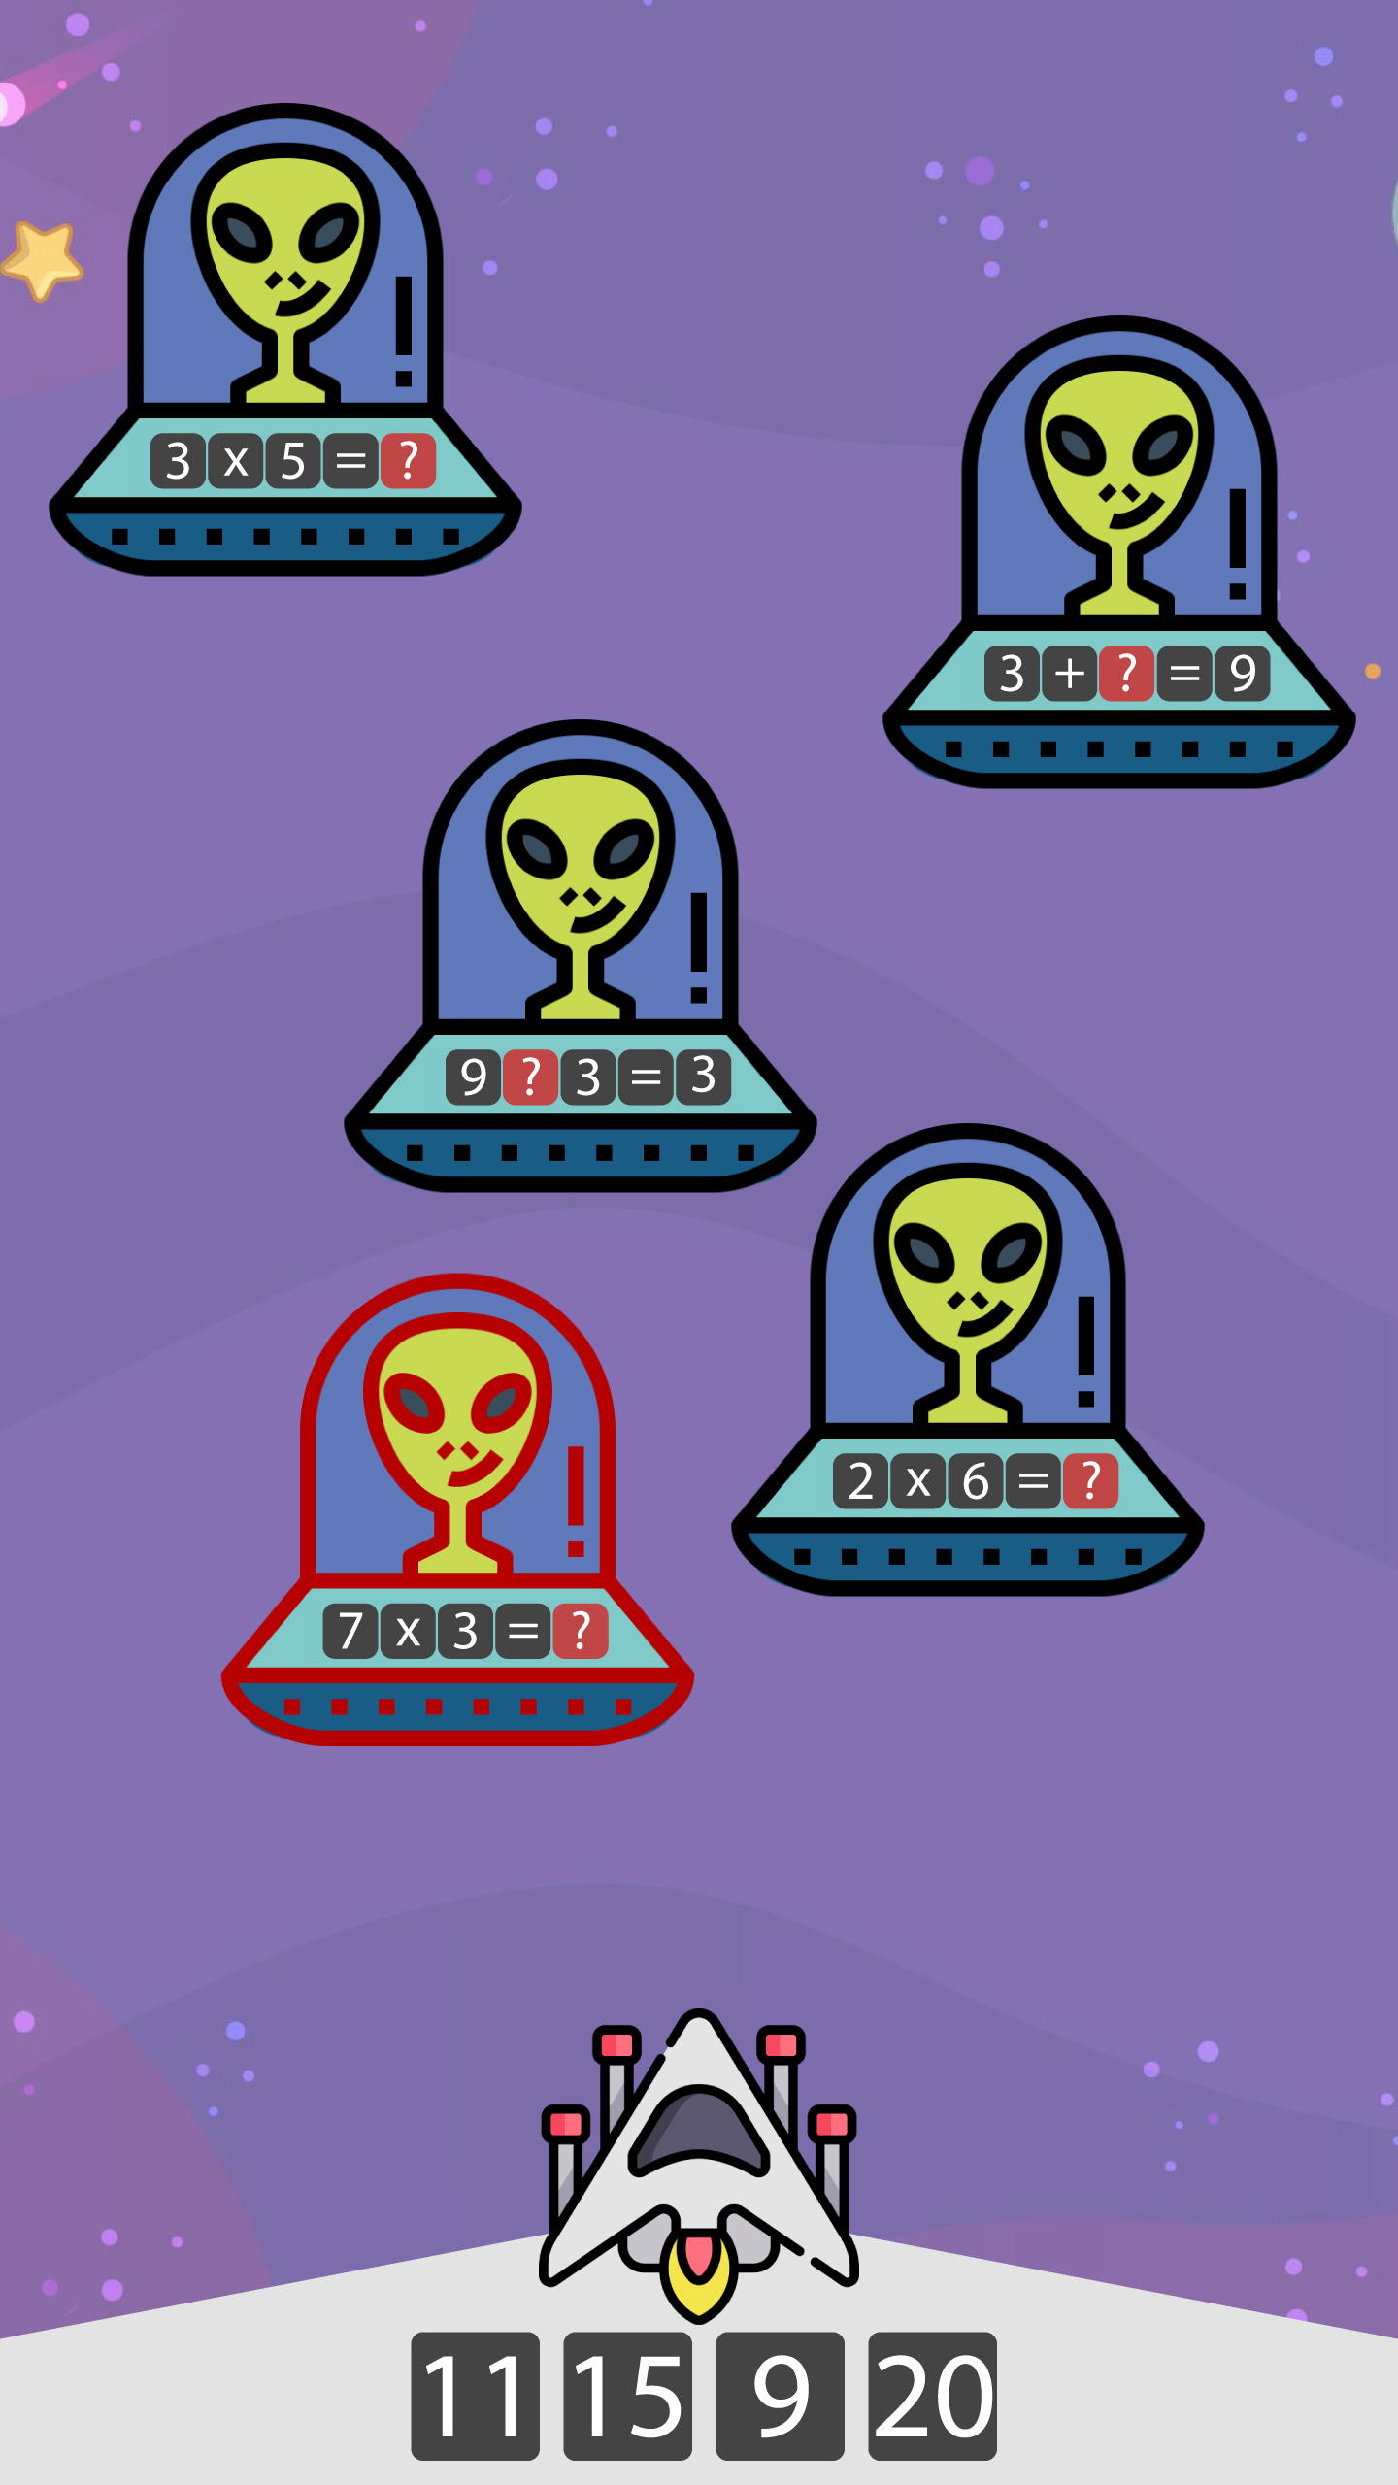
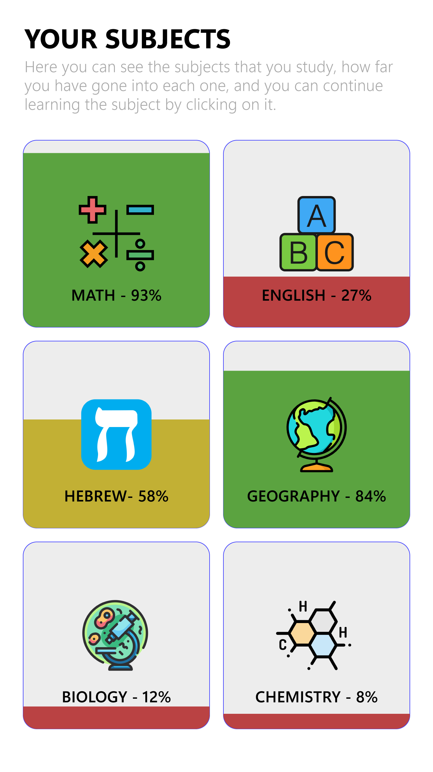
USER INTERFACE
20

Slide 22
Thanks!
Do you have any questions?
natalyl@braude.ac.il
arraf.shokry.as@gmail.com amran.zoabi@e.braude.ac.il
22

